Slide 1
French 499/379 Eighteenth Century France Through Digital Archives and Tools
Rochelle Lundy and Maryam Fakouri
Jan. 31, 2018

Slide 2
Agenda
Property law generally
What copyright protects
Copyright duration
How to obtain copyright protection
Rights included in copyright
Using other people’s works: licensing and fair use

Slide 3
CAUTION!
Nothing in this presentation is legal advice.
You may leave with more questions than you had when you arrived.
You might find copyright law to be interesting.
Notes:
Audience discretion is advised.

Slide 4
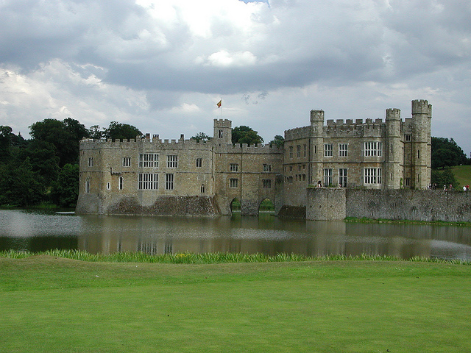
In the beginning . . .
Leeds Castle by T. S. Smith is licensed under CC BY.
Notes:
In the beginning there was private ownership of land. Like this castle in Spain. Probably ownership descended to the owners children. Our property law comes from the English tradition, which has several safeguards around exclusive ownership of private land. Land was, and is, wealth.

Slide 5
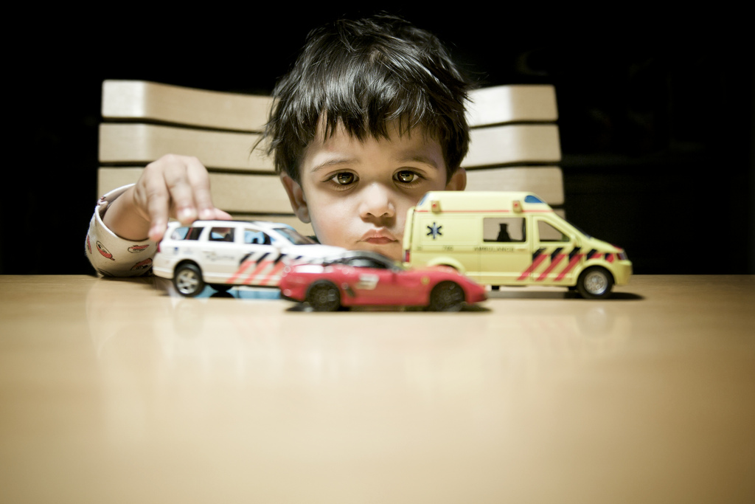
Cars by Philippe Put is licensed under CC BY NC.
Then . . .
Notes:
The notion of exclusive ownership of property extends from actual land to objects.
Critical notion of property ownership is that it’s exclusive. Even small children have a firm sense of ownership. Kids learn the word “mine” pretty early. Auggie Beestrum.

Slide 6
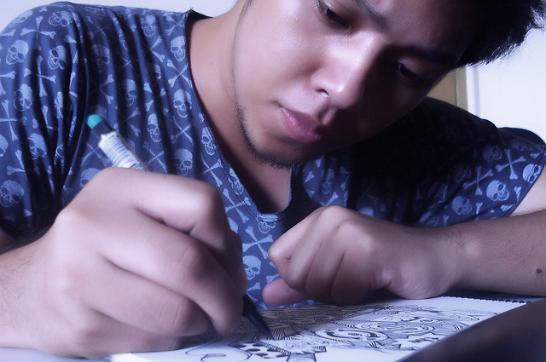
. . . and then . . .
Seriously doodling LOL by Anjo Bolarda is licensed under CC BY SA.
Notes:
Eventually the notion of exclusive rights of use extended from land to objects to products of intellect.

Slide 7
Intellectual Property Protections
Copyright protects expressive works.
Trademark protects symbol used to designate the origin of a good or service used in commerce.
Patent protects processes, machines, inventions, manufacturing methods, and their improvements.
Trade secret protects information that derives value from not being known, e.g., a secret recipe.
Notes:
Copyright is one form of intellectual property.

Slide 8
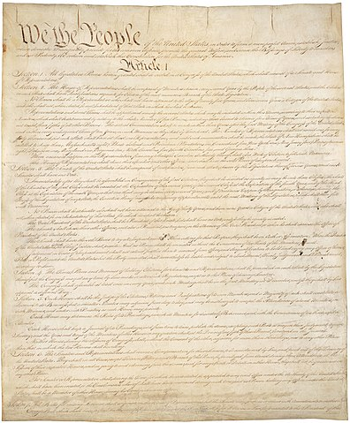
Copyright & the Constitution
“The Congress shall have Power…
To promote the Progress of Science and useful Arts, by securing for limited Times to Authors and Inventors the exclusive Right to their respective Writings and Discoveries”
(U. S. Const. art. I, § 8)
Notes:
U.S. copyright laws are grounded in the Constitution – grants specific powers to Congress to make laws
Motivation reflected in the clause – intended to promote public culture by incentivizing creation of new works, but restricting protection granted to a limited time

Slide 9
What does copyright protect?
Copyright protects original works of expression with more than a “modicum of creativity” that are fixed in a tangible medium of expression. These include (17 U.S.C. §102):
literary works
musical works, including accompanying words
dramatic works, including accompanying music
pantomimes and choreographic works
pictorial, graphic, and sculptural works
motion pictures and other audiovisual works
sound recordings
architectural works
Notes:
Original
Works of expression
More than a modicum of creativity – Modicum? to come
Fixed in a tangible medium of expression

Slide 10
What is not protected by copyright?
Facts
Ideas
Discoveries
Systems and processes
Works in the public domain
Useful articles
Short titles
Works by the US federal government
Notes:
Why are these things not protected by ©? We‘ll explore in examples to come.
Fact- nobody owns
Idea – not yet fixed
Discovery – other body of law
Public domain – often works whose © has expired
Useful articles – no © because we don‘t want them to be monopolized, e.g. fork, clothing
Systems and processes – other body of law
Short titles, e.g. Modern Love(rs), Black Star (Bowie, Talib Kweli and Mos Def, Acril Lavigne and others).
Works by the fed gov‘t

Slide 11
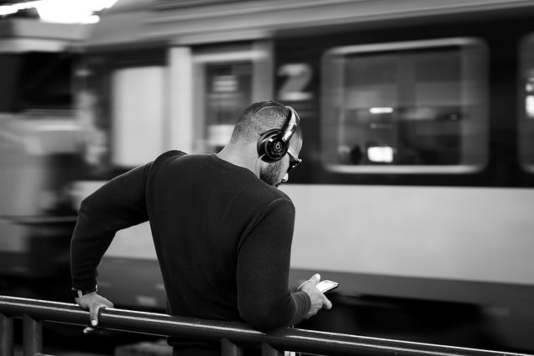
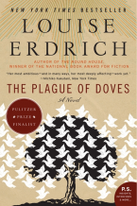
Is this protected by copyright?
B. Pop song recording
A. Novel

Slide 12
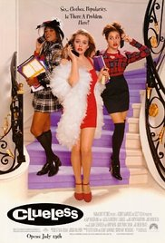
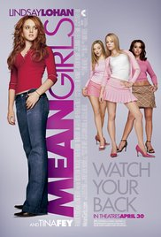
Is this protected by copyright?
B. Screenplay
A. Plot
A new student befriends popular girls at a high school.
Notes:
Mean Girls or Clueless or another movie?
Fixation. Idea / Expression dichotomy.
Why? We know what’s protected.
This plot could flower into many possible stories. “Clueless” and “Mean Girls” scripts are copyrightable expressions because they are fixed (specific), display more than a modicum of creativity.

Slide 13

Is this protected by copyright?
A. Notes
B. Simple recipe for egg salad
Place egg in a saucepan and cover with cold water. Bring water to a boil and immediately remove from heat. Cover and let eggs stand in hot water for 10 to 12 minutes. Remove from hot water, cool, peel and chop.
Place the chopped eggs in a bowl, and stir in the mayonnaise, mustard and green onion. Season with salt, pepper and paprika. Stir and serve.
Notes by INPIVIC Family is licensed under CC BY.
Notes:
A “modicum of creativity” is pretty low.
Simple procedures are not protected. Recipes in particular are not. BUT creative expressions of recipes might be protected, e.g. lots of commentary in the recipe, drawings, photos. Smitten kitchen food blog.

Slide 14
How long does copyright last?
For works with known human authors
Life of the (last surviving) author + 70 years
For works for hire or works with anonymous authors, the shorter of
120 years after creation
95 years after publication
For works created prior to 1978, the situation can be complicated.
Notes:
Bottom line safe bet: Assume everything created after 1923 is protected.

Slide 15

Asparagus by Pat Kight is licensed under CC BY NC ND.
What is copyright?
Copyright is a bundle of rights.
Like this bundle
of asparagus.
Notes:
In sum, © is a bundle of rights. You can manage the individual rights independently. For example, you can license the right to make a derivative work of your fiction writing.

Slide 16
A copyright owner “has the exclusive rights to do and to authorize any of the following” (17 USC §106):
• Reproduce a work
• Prepare a derivative work
• Publicly distribute a work
• Publicly display a work
• Publicly perform a work
• In the case of sound recordings, to perform the work publicly via digital audio transmission
Notes:
Single work but plural concept. We should say copyrights.
What do these rights have in common? Why would we protect these things?
They are ways to monetize creative works. Also publicize works.

Slide 17
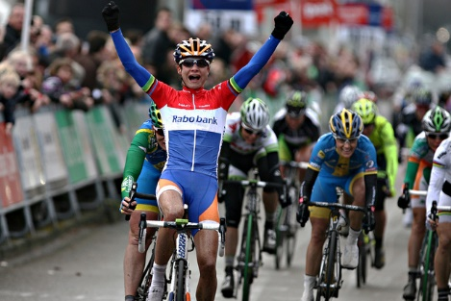
Is this a photographer’s exclusive right?
A. Publish his photograph of Marianne “the Cannibal” Vos in Sports Illustrated magazine
B. Clip the photo from Sports Illustrated and put in on his refrigerator for motivation
Marianne Vos wins over Kristen Wild and Emma Johansson by anMarton is licensed under CC BY NC ND.
Notes:
A. Exclusive right of photographer. Publications license photos from photographers
B. Probably not an EXCLUSIVE right. Use is not reproducing the image or displaying it publicly. Not a public display. Not public distribution. Image is already published.
ANALOG example.

Slide 18
Is this a photographer’s exclusive right?
A. Publish his photograph of Marianne “the Cannibal” Vos on his blog
B. Download the photo from his blog and use it as his screensaver for motivation
Marianne Vos wins over Kristen Wild and Emma Johansson by anMarton is licensed under CC BY NC ND.
Notes:
Exclusive right of photographer.
B. Technically it’s a violation of © because it involves copying the work. Even tho user is not displaying the photo publicly. Not distributing the photo publicly. Image is already published. But it’s de minimus infringement unless the photo has CC or other license allowing this use.
Linking is not an infringement because there is not duplication.
Digital is different because it involves copying work.

Slide 19
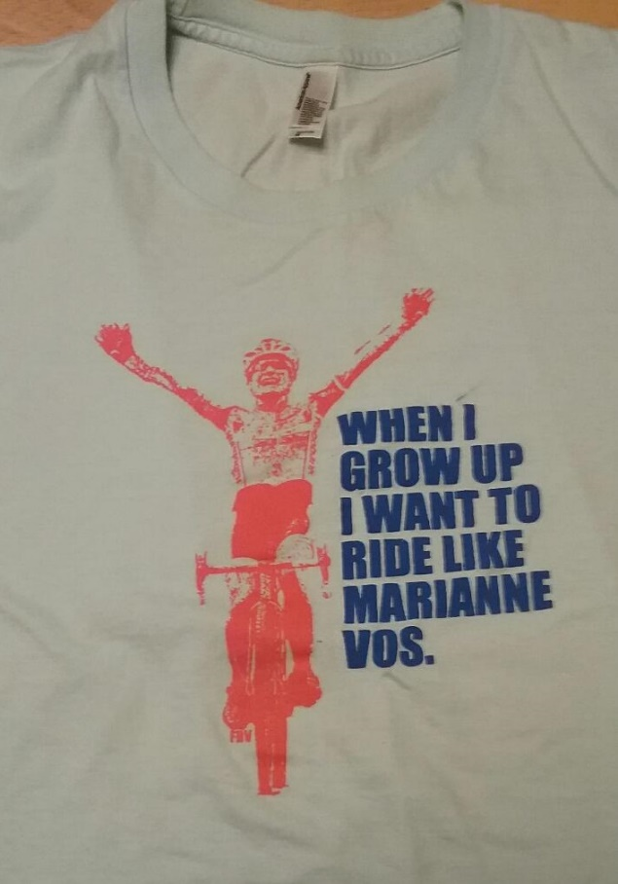
Is it a photographer’s exclusive right to alter his photo, put it on tee shirts, and sell them?
Marianne Vos wins over Kristen Wild and Emma Johansson by anMarton is licensed under CC BY NC ND.
Notes:
Is this fair use? Stay tuned! See http://cdas.com/cairou-v-prince/

Slide 20

Beyond the United States…
French Copyright Tradition:
Grounded in idea that authors have inherent rights in their creations
Encompasses moral rights (droits moraux) in addition to proprietary rights
International Copyright Protection – Berne Convention:
Harmonizes copyright protection for 170+ member countries
Protection is automatic – no need to register or undertake other formalities
‘National Treatment’ standard – works of member countries receive same protection to which works originating in that country are entitled
Notes:
French Tradition:
-unlike U.S. tradition, not based in idea that copyright benefits society by incentivizing creative works, but in idea that authors have inherent rights in their works
-moral rights – authors have rights beyond economic exploitation, i.e. to control how work is displayed, receive credit, whether work is altered, in relation to their creations
Berne Convention:
-protection can’t be conditioned on formalities – no need to register or do anything in another member country to benefit
-requires that member countries treat copyrighted works from other members at least as well as those of their own nationals

Slide 21
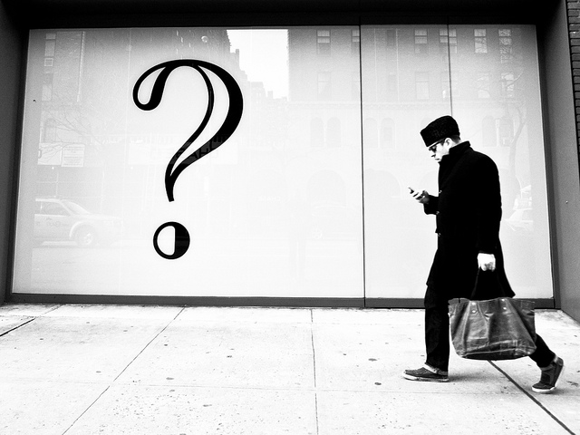
What if you want to use a work but you do not own its copyright?
More Questions Than Answers by Tom Waterhouse is licensed under CC BY NC.
Notes:
Here’s the big question.

Slide 22
What if you want to use a work but you do not own its copyright?
Get permission for the use
Be fair
Notes:
Here’s the big question.
-Permission – will be a license for use. Contractual agreement for use – often in exchange for a fee. Sports Illustrated photo example. Will have limits, such as designated uses, duration of permission, geographic boundaries, etc. We enter these agreements all the time, e.g. for software like the Microsoft Office suite, Netflix, Amazon Prime, Facebook.
-Be fair – developing area of law

Slide 23
What is a license?
A contractual agreement for permission to use a work
Often in exchange for a fee
Could be limited by user group, geography, time, number of uses, or types of uses
Notes:
When you acquire a license, you’ll have permission to exercise rights that are normally reserved for the © holder. Often your rights will be limited by duration and other factors. Expect to be charged a fee for your uses.

Slide 24
FAIR USE
Notes:
Big grey area.

Slide 25
17 USC §107 Limitations on exclusive rights: Fair use
[F]air use of a copyrighted work . . . for purposes such as criticism, comment, news reporting, teaching . . . scholarship, or research, is not an infringement of copyright. In determining . . . fair use the factors to be considered shall include—
(1) the purpose and character of the use, including whether such use is of a commercial nature or is for nonprofit educational purposes;
(2) the nature of the copyrighted work;
(3) the amount and substantiality of the portion used in relation to the copyrighted work as a whole; and
(4) the effect of the use upon the potential market for or value of the copyrighted work.
Notes:
Educational uses are examples of favored purposes of use. Purpose is one of four factors.

Slide 26
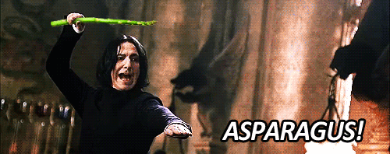
Substantiality Nature Amount Purpose Effect on market
Notes:
Just for fun. Memory device for 5 factors instead of 4.

Slide 27
Fair Use Trueisms
Fair use is deliberately flexible.
Each situation is different.
Nobody can say in advance whether a use is fair or not.
It requires thinking, so it’s fun.
Notes:
Educational use is not a guarantee that a use is fair.

Slide 28
INSERT SLIDE ABOUT GOOGLE BOOKS. Students should have read edited opinion prior to class.

Slide 29
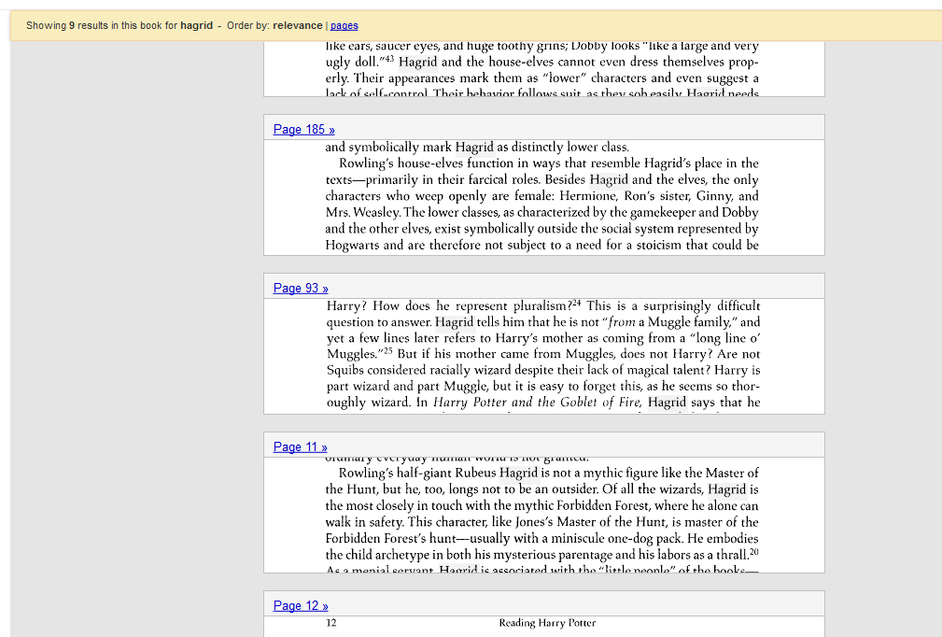
Authors Guild, Inc. v. Google, Inc.
Screenshot of partial search results for “Hagrid” in the book Reading Harry Potter: Critical Essays edited by Giselle Liza Anatol using Google Books

Slide 30
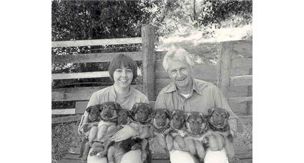
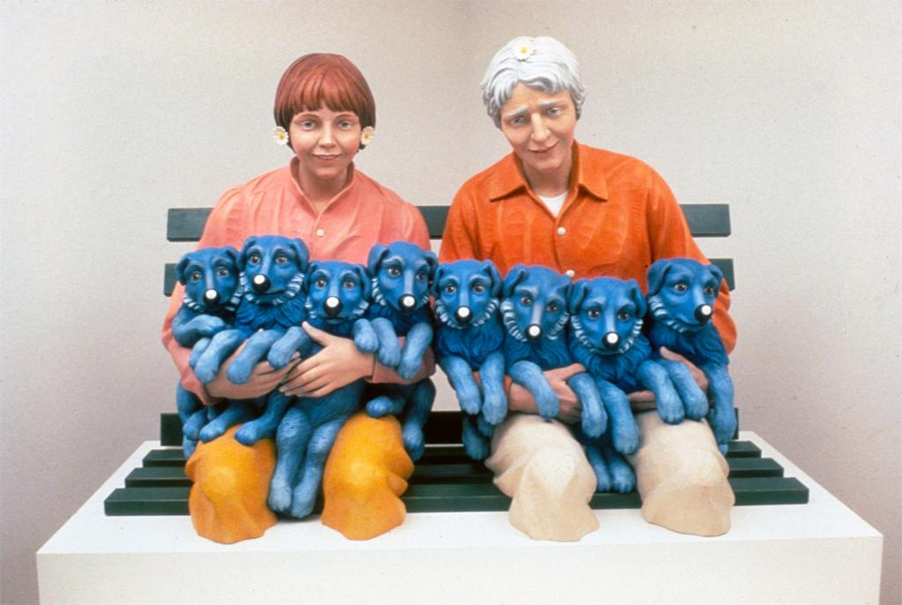
Rogers v. Koons
String of Puppies. Jeff Koons . 1988. In ARTstor [database online]. 9 December 2014. Available from ARTstor, Inc. New York, New York.
Notes:
EXAMPLE 1: Rogers v Koons (1992) Puppies
1. Hand out fair use checklists.
2. Assign a student to be scorekeeper for factors. How many for fair use? How many against?
Facts: Art Rogers earned his living by creating and licensing his photographs. His work was exhibited widely. In 1980, a couple asked him to photograph them with their 8 German shepherd puppies. Rogers arranged the lighting as well as the positions of the people and their dogs. Rogers sold a print of the photograph to the couple, then licensed it to commercial users including a greeting card company.
Jeff Koons bought a greeting card with Rogers’s image at a shop. He liked the image because he thought it tied into the “collective subconscious”. In other words, he thought it would seem familiar to viewers even if they hadn’t seen it before. Koons tore the credit information from the card. He then instructed a workshop in Italy to recreate the subjects of the photo in wood, stressing that the wooden sculptures be faithful to the photograph. The resulting sculpture was included in his exhibit, “The Banality Show”, at his gallery in New York. Rogers sued for copyright infringement.
Ask students to go through factors one-by-one and explain whether they feel Jeff Koons’s use is fair. Then compare students’ reasoning with the judges (below).
Purpose - Koons argued he used the photograph to comment on and satirize society at large. The court acknowledged that satire and parody are accepted forms of fair use, but thought that Koons’ work did not belong to this tradition.
Court’s definitions: “Parody or satire . . . is when one artist, for comic effect or social commentary, closely imitates the style of another artist and in so doing creates a new art work that makes ridiculous the style and expression of the original.”
Satire = critique of society
Parody = critique of a work
It’s possible to parody a work as part of a satire of society at large. But even so, the public must understand that the parody refers to a separate, original work. “The rule's function is to insure that credit is given where credit is due. By requiring that the copied work be an object of the parody, we merely insist that the audience be aware that underlying the parody there is an original and separate expression, attributable to a different artist.“ Usually because the targeted work is well-known or because the artist acknowledges the targeted work.
Koons argued that by reproducing the photo he was satirizing society at large, but he didn’t make a parody of the original photo. If this is allowed, everyone could copy works closely and argue they are satirizing larger themes (e.g. all of society). A parody must reference (not copy) an original work, and the audience must know that a separate work is being targeted. An artist must “give credit where credit is due.”
“[E]ven given that "String of Puppies" is a satirical critique of our materialistic society, it is difficult to discern any parody of the photograph "Puppies" itself. . . . Koons' copying of the photograph "Puppies" was done in bad faith, primarily for profit-making motives, and did not constitute a parody of the original work.”
The nature of the work was creative and artistic.
The amount of work used was greater than necessary for a parody.
Effect on the market - the court considered not only the market for the original but also the market for derivative works. Koons’s use reduced a potential market for other reproductions of Rogers’s work.
The judges wrote, “The copying was so deliberate as to suggest that defendants* resolved so long as they were significant players in the art business, and the copies they produced bettered the price of the copied work by a thousand to one, their piracy of a less well-known artist's work would escape being sullied by an accusation of plagiarism.”
*Koons’s gallery was a codefendant.

Slide 31
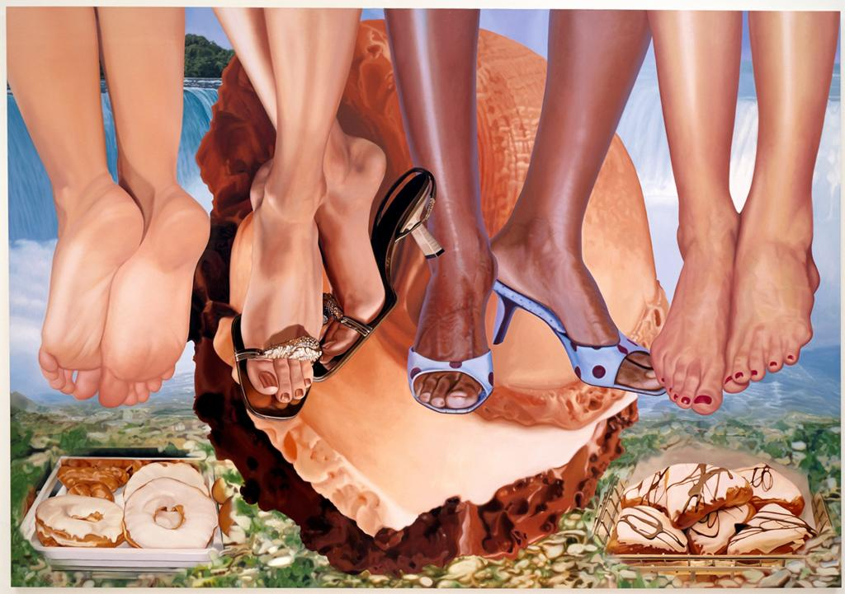
Blanch v. Koons
Niagara. Jeff Koons. 2000. In ARTstor [database online]. 9 December 2014. Available from ARTstor, Inc.
New York, New York.
Notes:
Blanch v. Koons (2006)
Photographer Andrea Blanch saw this painting by Jeff Koons on display and recognized two legs and feet from a fashion photo shoot she had done for Condé Naste Publications. She had not licensed her work to Koons or any other artists. She sued Koons for copyright infringement.
The court’s fair use analysis:
• Koon’s purpose was transformative in 2 ways.
1) The original was a picture in a magazine photo while Koons’ work was painting.
2) Koons used the work with a different purpose than Blanch did; he juxtaposed images from popular culture so that “the viewer [would] think about his/her personal experience with these objects, products, and images and at the same time gain new insight into how these affect our lives.” Koons used the photo to comment on ubiquitous fashion photographs.
The public benefit in making art is greater than the commercial nature of this use.
Koons did not gain from rote reproduction; he transformed the image into something new.
• Nature of the work was creative, which weighed against fair use.
• Amount and substantiality of the portion used were reasonable in light of Koon’s purpose.
• No market effect on Blanch’s work because she did not license her photographs or use them after they were published, and she had no plans to do so with the photo in question. Koons’s use of her work did not affect her career plans.

Slide 32
Summary
• Copyright is broad and exclusive.
• Use only enough of a work necessary to conjure the original.
• Transform work by
using it to create something new or
using it for a different purpose.
Be clear that your work comments on the original and does not substitute for it.
Choose your targets carefully. Beware of Walt Disney Corp.
Best practices explain community norms.
Understand options and consequences if infringement is alleged.
Notes:
No best practices expressly for remix/parody, but ‘Code of Best Practices in Fair Use for Online Video (http://archive.cmsimpact.org/sites/default/files/online_best_practices_in_fair_use.pdf) contains a useful discuss of fair use and its limits for ‘recombinant’ video works.
What might happen if a copyright owner thinks you have infringed their work (reminder – this is not legal advice!):
You receive notification from an online platform (YouTube, SoundCloud, GitHub, etc.) that they’ve received a ‘takedown notice’ for your content:
DMCA allows online platforms to avoid liability by disabling content someone has claimed is infringing – they will disable access to your content and notify you of the change
You have not been sued nor has the content owner personally identified you – they are (for now) merely seeking to have the content removed, but can use the notice as a basis for identifying and suing you in future
You can file a ‘counter notice’ if you believe your content is non-infringing to have it reinstated – be very careful when taking this step, as you are swearing under penalty of perjury that you believe that the takedown notice is mistaken (i.e. that you had a right to use the material) and identifying yourself to the copyright owner
You receive a ‘cease & desist’ letter or a letter asking you to pay a license fee:
The copyright owner is asking you to stop using their work and/or to pay them for using it, and may threaten to sue if you don’t
Obtain legal advice - don’t respond before doing so, as what you say or do could be used against you
You receive a ‘summons’ or other notice from a court:
Definitely obtain legal advice!
If you need legal advice, consider starting with a free consultation at UW’s Student Legal Services

Slide 33
Merci! Thank you!

